Slide 1
WELCOME

Slide 2
DISEASE PREDICATION
SYSTEM
BY
KAJAL YEWALE,
Ankita Khole
GUIDE
Prof. Charushila Chaudhari

Slide 3
INTRODUCTION
“Disease prediction” system based on predictive modeling predicts the disease of the user on the basis of the system.
The system analyzes the symptoms provided by the user as input and gives the probability of the disease as an output .
The disease prediction system predicts chance of presence present in a patient on the basis of their symptoms.

Slide 4
: IMPORTANCE AND SIGNIFICANCE
Early detection
Improved outcomes
Accessibility
Cost-effective
Personalized care
Research

Slide 5
OBJECTIVES
Providing accurate and reliable information
Offering personalized recommendations
Facilitating early detection and prevention
Promoting health education
Improving healthcare access

Slide 6
HYPOTHESES
H0 : The disease prediction system website does not accurately predict the likelihood of a person having a particular disease.
H1 : The disease prediction system website accurately predicts the likelihood of a person having a particular disease.

Slide 7
ADVANTAGES AND DISADVANTAGES
Advantages:
Personalized risk assessment
Improved access to healthcare
Early detection and prevention
Empowerment
Disadvantages:
Limited accuracy
Limited access
Over-reliance on technology

Slide 8
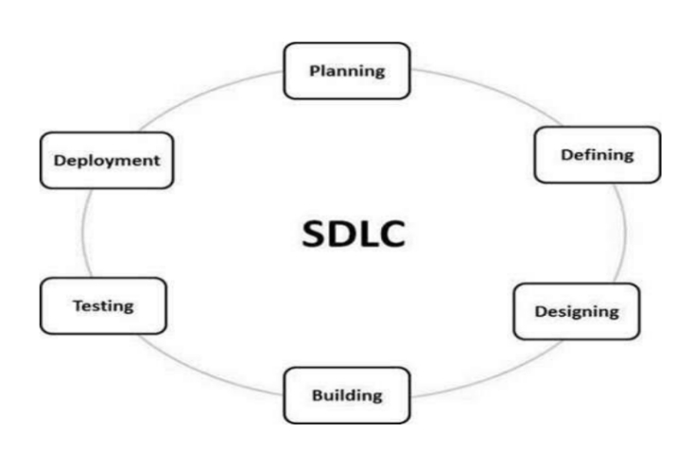
SYSTEM DESIGN & IMPLEMENTATION
SOFTWARE DEVLOPEMENT LIFE CYCLE
A typical Software Development Life Cycle consists of the following stages –
Planning Phase
Analysis Phase
Design Phase
Implementation Phase
Testing Phase
Deployment Phase
Maintenance Phase
Fig 1: - software Development life cycle.

Slide 9
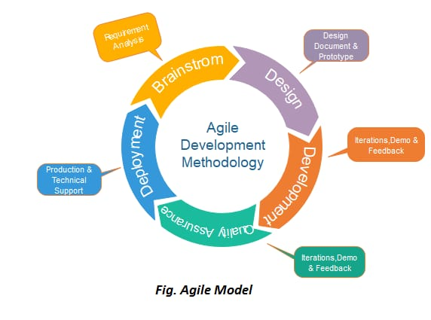
SOFTWARE DEVLOPEMENT MODEL
AGILE MODEL:
The sequential phases in Agile model are –
1. Requirements gathering
2. Design the requirements
3. Construction/ iteration
4. Testing
5. Deployment
6. Feedback
Fig 1: - Agile model

Slide 10
CLASS DIAGRAM

Slide 11
DFD ZERO LEVEL
User management
Symptoms management
Disease prediction system
Feedback management
Disease prediction management
Admin management

Slide 12
FIRST LEVEL
User management
Generate user report
Symptoms management
Generate symptoms report
Disease prediction system
Disease prediction management
Generate disease prediction report
Admin management
Generate admin report
Feedback management
Generate feedback report

Slide 13
SECOND LEVEL
Login to system
Check Roles of Access
Admin
Manage user Details
Forgot Password
Manage symptoms Details
Check Credentials
Manage Modules
Manage disease prediction Details
Send Email to User
Manage feedback Details
Manage System Admin
Manage Roles of User
Manage User Permission
Manage Report

Slide 14
SOFTWARE REQUIREMENTSPECIFICATION
MODULE DESCRIPTION
UI:
UI is the use to deal with perform operations on the data.
HTML is the standard markup language for creating web page.
Cascading Style Sheet is a style sheet language used for describing the presentation of a document written in a markup Language Such as HTML or XML.
Database: The Data Parsed from the PDF is then sent to Database to perform various operations. MySQL is an Oracle-backed open source relational database management system (RDBMS) based on Structured Query Language (SQL).

Slide 15
HARDWARE REQUIREMENTS
Web Browser:
Users will need a web browser to access the freelancing website. The website should be compatible with major web browsers like Google Chrome, Mozilla Firefox, Safari, and Microsoft Edge.
Operating System:
The freelancing website should be compatible with popular operating systems like Windows, MacOS, and Linux.
Internet Connection:
Users will need a stable and reliable internet connection to access the website.

Slide 16
SYSTEM REQUIREMENTS
Front End: -HTML, CSS, JAVA SCRIPT
Database: -My SQL
Back End: - PHP
Tools Required: -Visual studio code

Slide 17
TESTING
Login:
Verify that a user can successfully log in with valid credentials.
Verify that an error message is displayed when an invalid username or password is entered.
Verify that a user is redirected to the correct page after logging in.
Symptom selection:
Verify that a user can select one or more symptoms from a list.
Verify that a user can deselect a symptom that was previously selected.
Verify that the selected symptoms are saved when the user navigates to another page.

Slide 18
Disease prediction:
Verify that a user is presented with a list of possible diseases based on their selected symptoms.
Verify that the list of possible diseases is sorted by likelihood or severity.
Verify that the predicted diseases are accurate and consistent with the user's symptoms.
Feedback:
Verify that a user can submit feedback through a form on the website.
Verify that the feedback form includes all required fields.
Verify that an error message is displayed if the user tries to submit the form without completing all required fields.
Verify that the user receives confirmation that their feedback was successfully submitted.

Slide 19
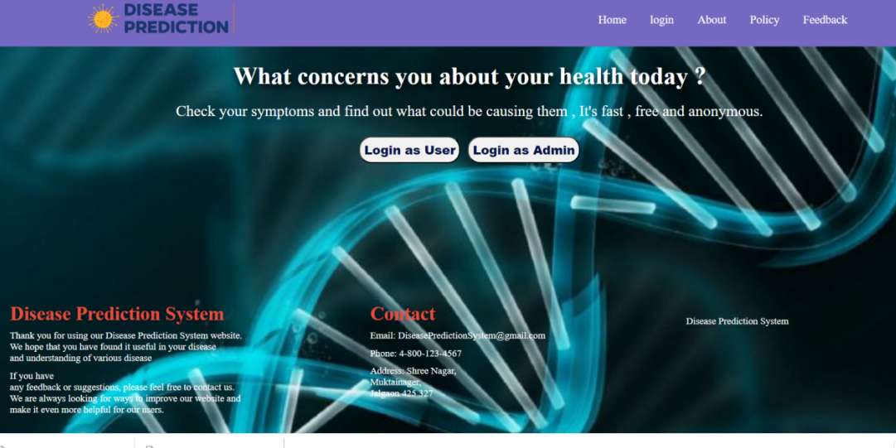
SNAPSHOTS
Home page:

Slide 20
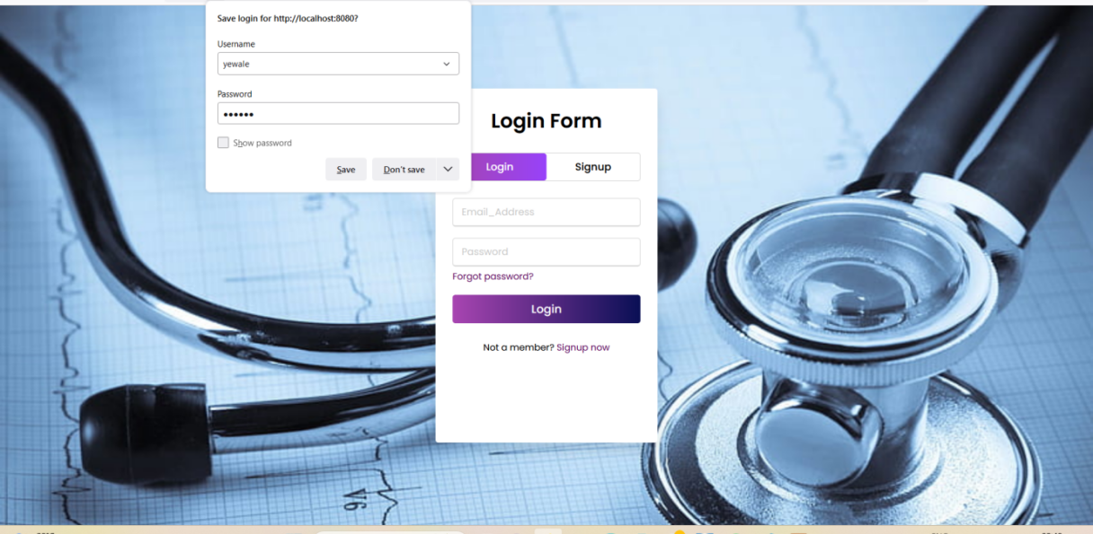
User Login/Signup

Slide 21
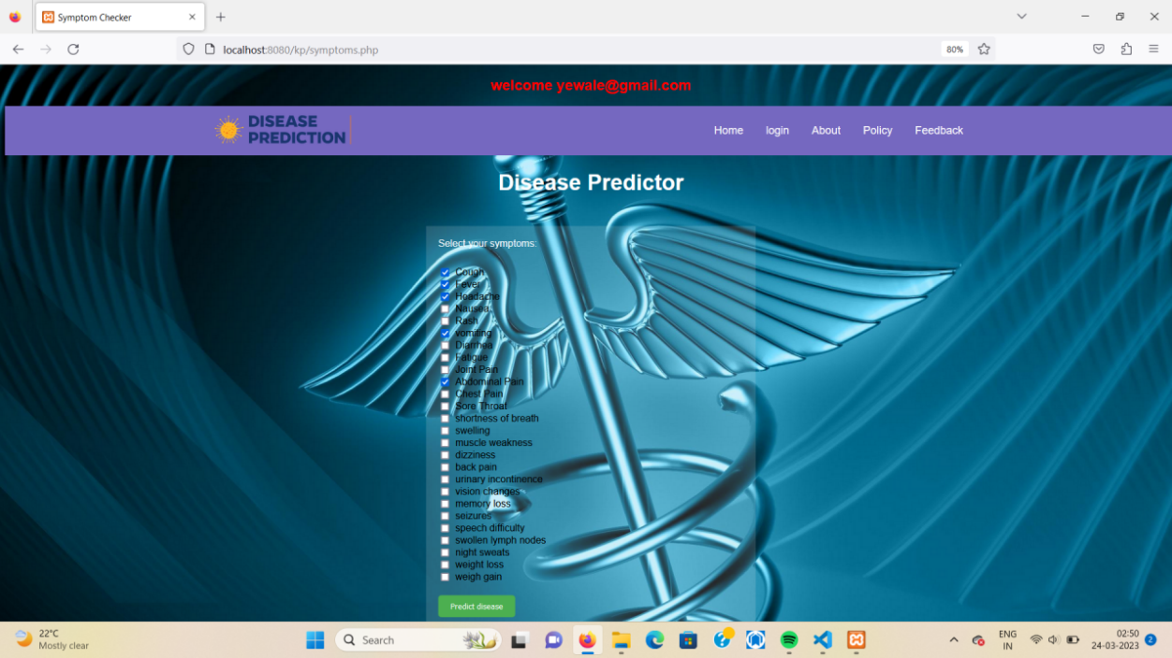
Symptoms Select:

Slide 22
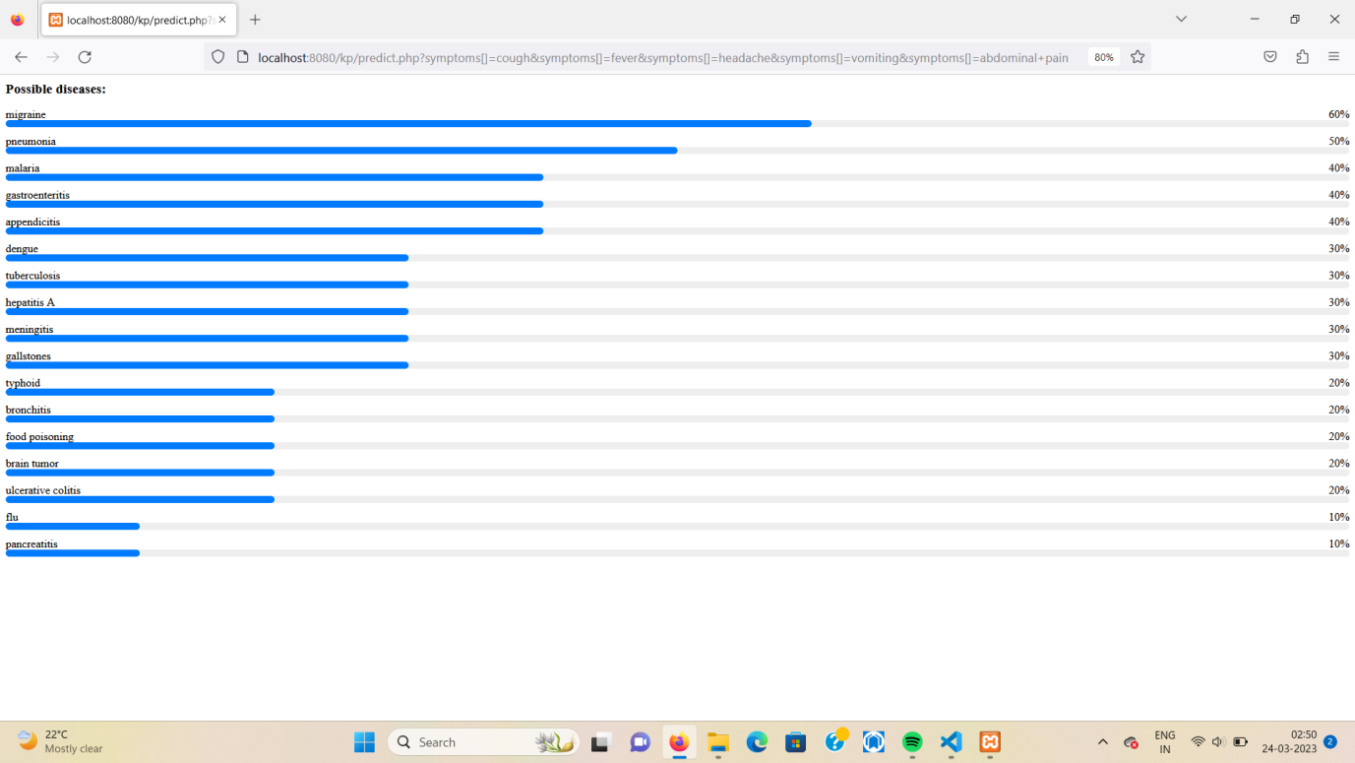
Possible Disease:

Slide 23

Admin Login:

Slide 24
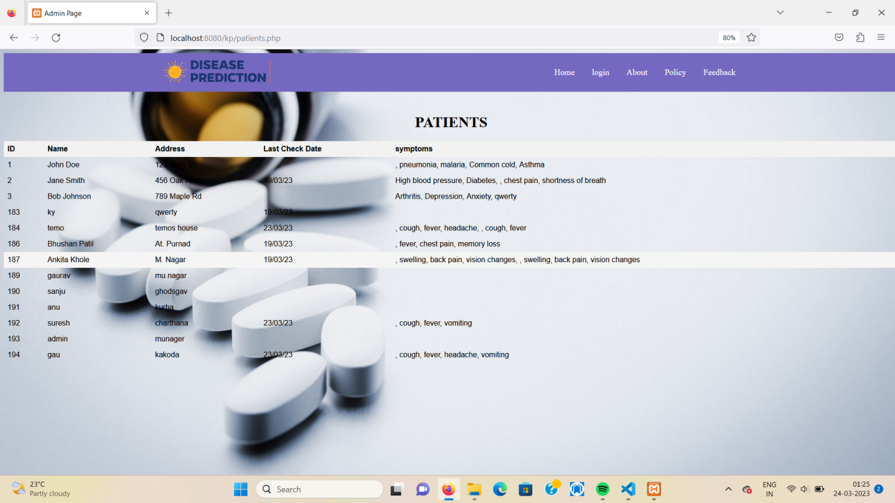
Patients Report:

Slide 25
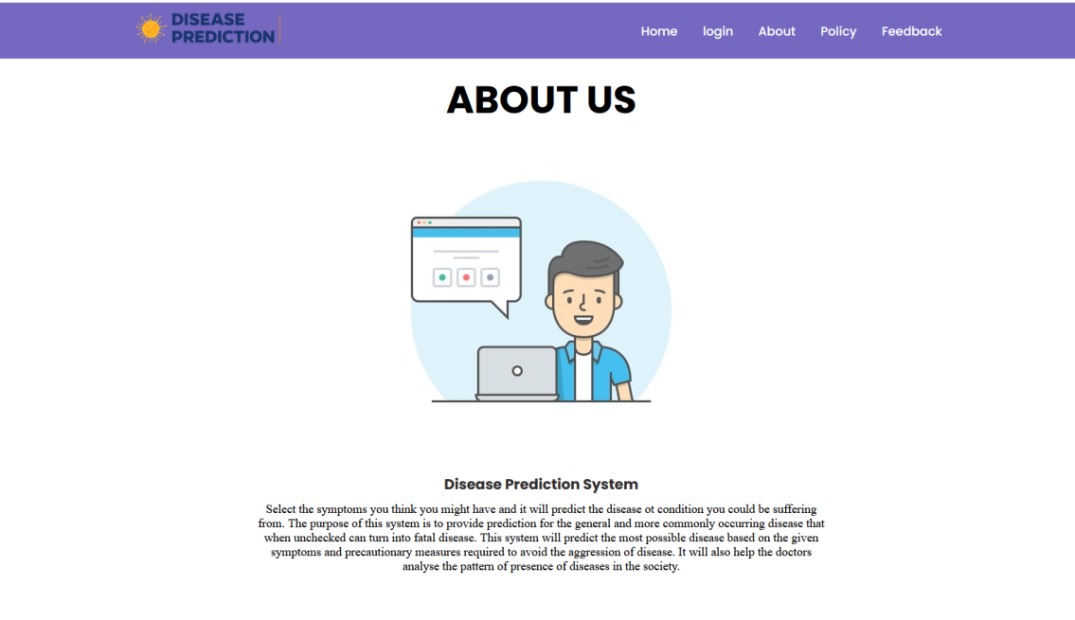
About Us:

Slide 26
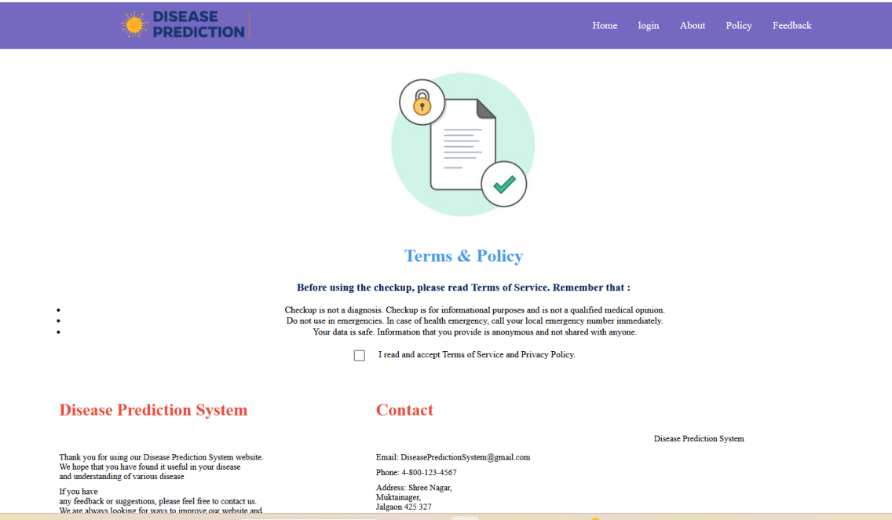
Policy

Slide 27
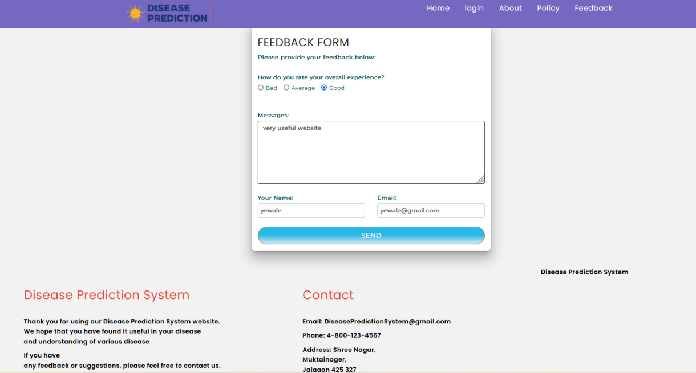
Feedback

Slide 28
CONCLUSION
The system covers the general diseases or the more commonly occurring diseases.
The plan is to include diseases of higher fatality, like various cancers in future ,so that early predication and treatment could be done, and the fatality rate of deadly disease like cancer decreases, with the economic benefit in long sight as well.

